Slide 1
Operational Data Integration and Intelligent Reporting
Traditional Data Management and Report
Phase | Method | Impact
Data Storage | Independent management systems (OEE, MES, SFC, SAP); Paper documents; Shared drives and folders (Excel/CSV); Distributed on personal computers; Personal regular backups or no backups; Network drives for casual storage | Data fragmentation with multiple versions, missing master data, difficult traceability and auditing; High risk of data loss and leakage, uncontrollable permissions, insufficient audit trails; No disaster recovery guarantee, critical data may be permanently lost
Data Collection | Manual forms and Excel consolidation; Manual cleaning, temporary scripts, word-of-mouth rules; Point-to-point export/import, manual sampling entry | Error-prone manual processes, low efficiency; Rules are not reusable and easily distorted, unstable data quality, long go-live cycles; High integration costs, poor stability, prone to "data silos"
Data Transmission | Email/Teams file transfer and screenshots; Email/chat data pulling and frequent reminders; Offline meetings for data reconciliation; File overwrite/rename; Changes broadcast via email | Long communication chains, frequent rework; Fragmented information difficult to consolidate, repetitive communication and long waiting times; No unified version control and audit trails, difficult rollback, frequent misuse
Report Presentation | Excel attachments/screenshots, paper reports, temporary reports; Data mostly weekly/monthly summaries, unable to adjust production scheduling and human-machine-material coordination timely; Each department calculates separately, varied data sources; Each department maintains definitions, definitions hidden in reports | Inconsistent definitions, information lag, difficult drill-down and linkage analysis; Poor timeliness, delayed decisions; Difficult to unify and change definitions, high cross-department alignment costs, frequent disputes

Slide 2
Operational Data Integration and Intelligent Reporting
4-Step Implementation Roadmap
Step 1
Storage Standardization
Step 2
Collection Automation
Step 3
Data Fusion & Definition
Step 4
Visualization & Access
Key Activities ：
  Establish master data and data dictionary, unify field naming/units/precision
  Connect OEE/MES/SFC/SAP, implement dimensional-fact data model
  Build layered storage with access control/audit/backup strategy
Key Activities ：
  Unified API/message/batch sync, establish collection schedules and retry mechanisms
  Configurable rules and version management
  Data quality validation: completeness, uniqueness, timeliness, anomaly alerts
Key Activities ：
  Unify KPI algorithms and calculation definitions (yield, OEE, scrap, etc.), establish normative documents
  Multi-source reconciliation and primary key mapping (work orders/batches/equipment/shifts), eliminate data silos
Key Activities ：
  Direct web access to reports, support mobile/computer/workshop big screens
  Power BI platform, support data linkage and drill-down
  Real-time/near real-time dashboards and self-service analysis
  Role-based access permission management
Benefits ：
  Source consistency and traceability, reduce definition disputes
  Controllable permissions and compliance, lower loss and leakage risks
Benefits ：
  Reduce manual costs and error rates
  Data timeliness improved from weeks/months to hours/minutes
Benefits ：
  Eliminate "report conflicts", comparable and reusable metrics
  Quick anomaly and bottleneck identification, support continuous improvement
Benefits ：
  Multi-device access (mobile/computer/big screen), view anytime anywhere
  Real-time data updates, support self-service drill-down analysis
  Fine-grained permission control, data security and compliance

Slide 3
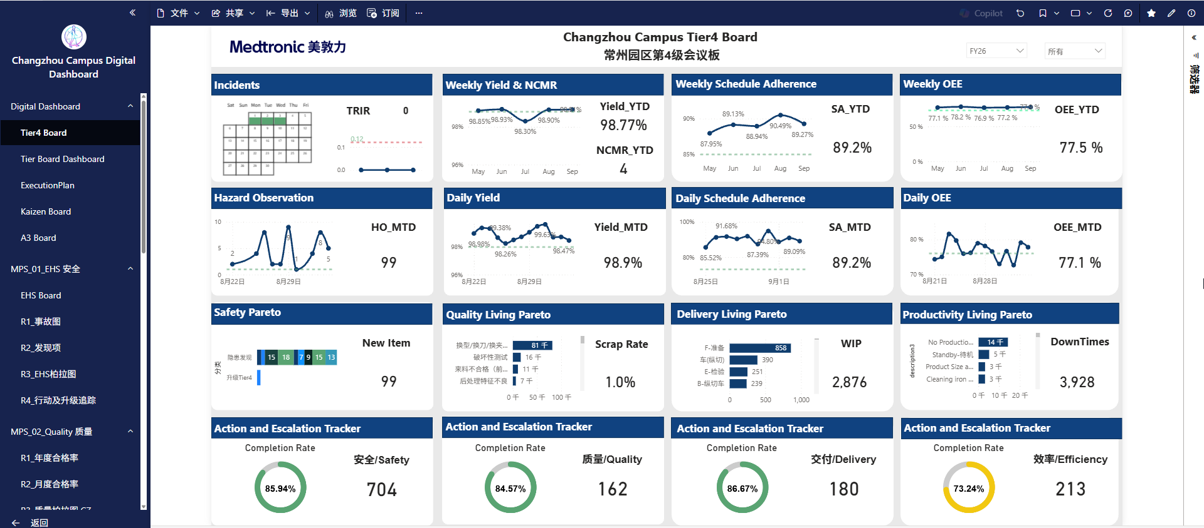



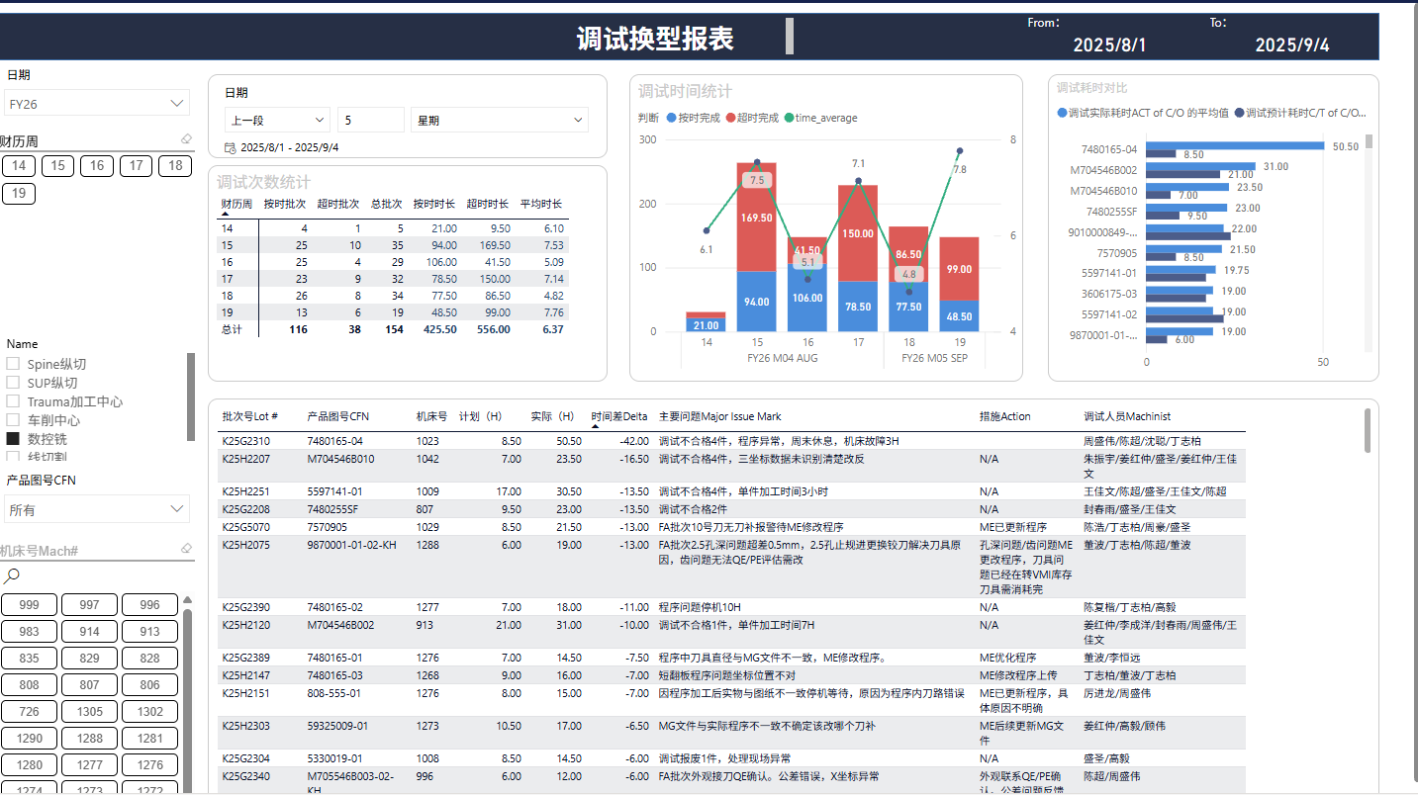
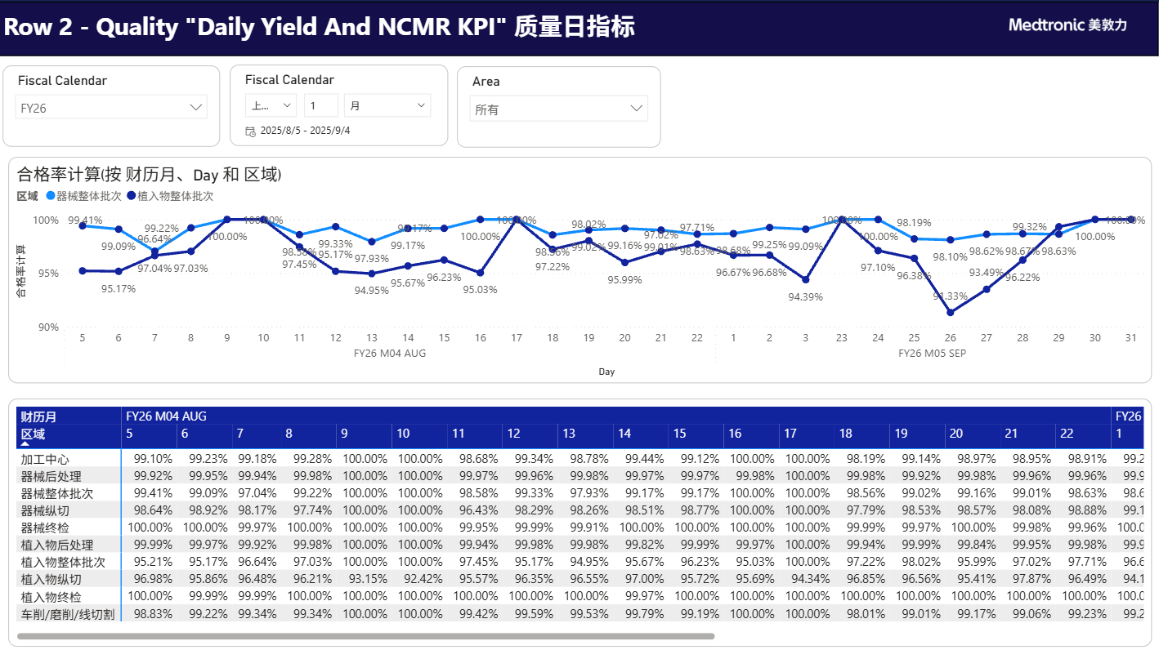

Operational Data Integration and Intelligent Reporting
Results & Value Realization
100% Data Accuracy
8 Connected Systems
42 Reports
7Departments
128Users

Slide 4
Operational Data Integration and Intelligent Reporting
4 STEP
Step 1
数据存储标准化
Step 2
数据集成自动化
Step 3
数据融合与统一
Step 4
可视化呈现与预警
Step 1 | Step 2 | Step 3 | Step 4
存储标准化 | 采集自动化 | 数据融合与定义 | 可视化和访问
关键活动： • 建立主数据与数据字典，统一字段命名/单位/精度 • 对接 OEE/MES/SFC/SAP，落地主题数据模型（维度-事实） • 构建分层存储（ODS/DWD/DWS/ADS）与权限/审计/备份策略 优势： • 源头一致性与可追溯，减少口径争议 • 权限可控与合规，降低丢失与泄露风险 | 关键活动： • 统一接入 API/消息/批同步，制定采集计划与失败重试 • ETL/ELT 编排，规则可配置与版本化管理 • 数据质量校验：完整性、唯一性、及时性、异常告警 优势： • 降低人工成本与错误率 • 数据时效由周/月提升到小时/分钟 | 关键活动： • 统一 KPI 算法与计算口径（良率、OEE、报废等），建立规范文档 • 多源对账与主键映射（工单/批次/设备/班次），消除数据孤岛 • 衍生指标计算、数据血缘与影响分析 优势： • 消除"报表打架"，指标可比可复用 • 快速定位异常与瓶颈，支撑持续改进 | 关键活动： • 直接网址访问报表，支持手机/电脑/车间大屏 • Power BI 平台，支持数据联动与下钻 • 实时/准实时看板与自助分析 • 角色化访问权限管理 优势： • 多端访问（手机/电脑/大屏），随时随地查看 • 实时数据更新，支持自助分析下钻 • 权限精细管控，数据安全可控

Slide 5
Operational Data Integration and Intelligent Reporting
Traditional Data Management and Report
阶段 | 方式 | 影响
数据存储 | OEE、MES、SFC、SAP等独立管理系统； 纸质单据； 共享盘与独立文件夹（Excel/CSV）； 分散在个人电脑； 个人定期备份或不备份； | 数据分散与版本众多，主数据缺失，追溯与审计困难； 丢失与泄露风险高，权限不可控、留痕不足； 灾备与恢复无保障，关键数据可能永久丢失.
数据采集 | 手工填报与Excel汇总； 手动清洗、临时脚本、口口相传的规则； 点对点导出/导入，人工抽样录入 | 人工易错、效率低下； 规则不可复用且易失真，数据质量不稳定、上线周期长； 接入成本高、稳定性差，易形成“数据孤岛”
数据传输 | Email/Teams传递文件与截图； 邮件/群聊拉数与催更；线下会议对表； 文件覆盖/重命名； 变更通过邮件广播 | 沟通链路长、返工频繁； 信息碎片化且难沉淀，重复沟通与等待时间长； 无统一版本控制与审计轨迹，误用频发
报表呈现 | Excel附件/截图、纸质汇报、临时报表； 数据多为周/月汇总，无法及时调整排产与人机料协同； 各部门分别统计，数据来源有差异；各部门各自维护定义，口径隐藏在报表中 | 口径不一致、信息滞后，难以下钻与联动分析； 时效性差，决策滞后； 口径难统一且难变更，跨部门对齐成本高、争议多

